Slide 1

A project Report On (CRUD) iNotes Web Apps
Submitted By: Submitted To:
SHAHID AKHTAR(18CSE194) Rasmita Panigrahi
SHRABAN SHAH(18CSE193)
SATISH PANDIT(18CSE190) Faculty of computer science engineering
(2018-2022)

Slide 2
Introduction:-
CRUD is an acronym that comes from the world of databases. Each letter stands for one type of action that a user can perform on a set of data: Create, Read, Update, and Delete. In relational databases, the four activities match the SQL commands INSERT, SELECT, UPDATE and DELETE. This “iNotes” application have help to take only important notes in relevant way. No user need to spend more time to take notes.Its very easy way to take notes. Any kind of user can upload they their notes as what time they want. Its take very less time to open the”iNotes apps”.Due to the very easy design of this apps, school students can also use this apps to take their notes in efficient manner.

Slide 3
Importance and need of iNotes:-
As it is developed for user-friendly so any sort of users can add their notes from any educational platform. They needn’t need to go through any other online offline software. This iNotes apps help to take key point of important notes. As we are in this technical world so hard copy notes is not portable. There is a lot of chance to loosing notes so this apps is make free risk of such loosing notes. User can keep their notes for future reference without any risk.

Slide 4
Motto of iNotes:-
The main motto of this project is to user can add or upload notes easily and very quick than other software.
User can modify their notes in very easy manner comparatively than other software.
Notes repositories are available in the form of table manner so it is easy to identify your notes without wasting your time.
Users can login from any location and upload notes and can share too.

Slide 5
Requirement Gathering:-
Typically, requirements gathering refers to specially to the practice of defining software requirements. At its core, this is the process of understanding what you’re supposed to be building, and why you’re building it. So “iNotes” is developed for all kind of user from higher level to lower level. Many students and people do not want to take their notes with themselves every time. so removed such sort of problems this "iNotes” Apps is developed.

Slide 6
Working Principles & Methodology:-
In this project “iNotes” every user have their own username and password to access this Apps and can keep their notes personally.
He/she can keep their notes with Title name and description so that user can easily recognize their notes he/she uploaded.
This is very easy to identify their notes repositories in home screen itself.
The user can easily search their notes in searching bar and filter too.

Slide 7
Hardware requirements:-
In hardware requirement we require all those components which will provide us the platform for the development of the project. The minimum hardware required for the development of this project is as follows-
Laptop / Pc with keyboard and mouse
RAM- minimum 128 MB
Hard disk- minimum 5 GB
processor- Intel CORE i5
CD drive
These all are the minimum hardware requirement required for our project. We want to make our project to be used in any. Type of computer therefore we have taken minimum configuration to a large extent.128MB ram is used so that we can execute our project in a least possible RAM.5GB hard disk is used because project takes less space to be executed or stored. Therefore minimum hard disk is used. Others enhancements are according to the needs.

Slide 8
Software requirements:-
Software’s can be defined as programs which run on our computer. It act as petrol in the vehicle. It provides the relationship between the human and a computer. It is very important to run software to function the computer. Various software’s are needed in this project for its development which are as follows-
Operating System- windows10
Visual studio code
Google chrome
MySQL database
Xampp Control panel (for local server)
We will be using visual studio code basic as our front hand because it is easier to use and provides features to the users which is used for the development of the project.

Slide 9
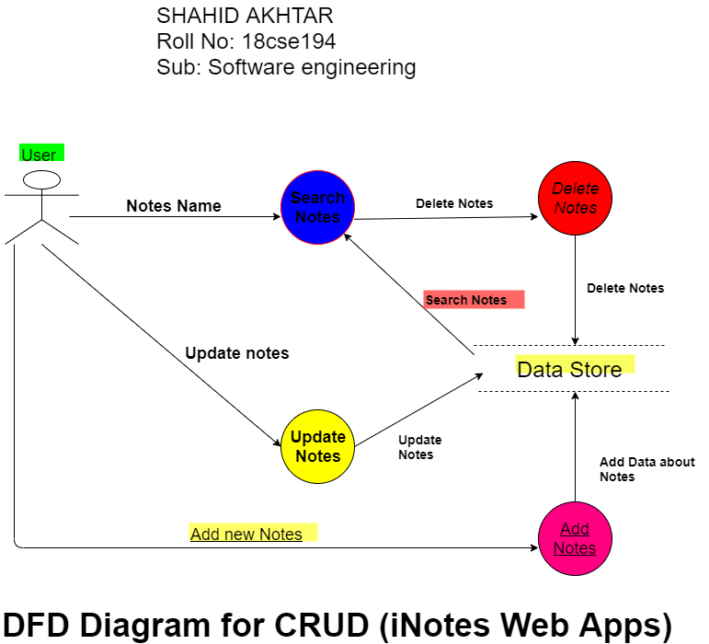
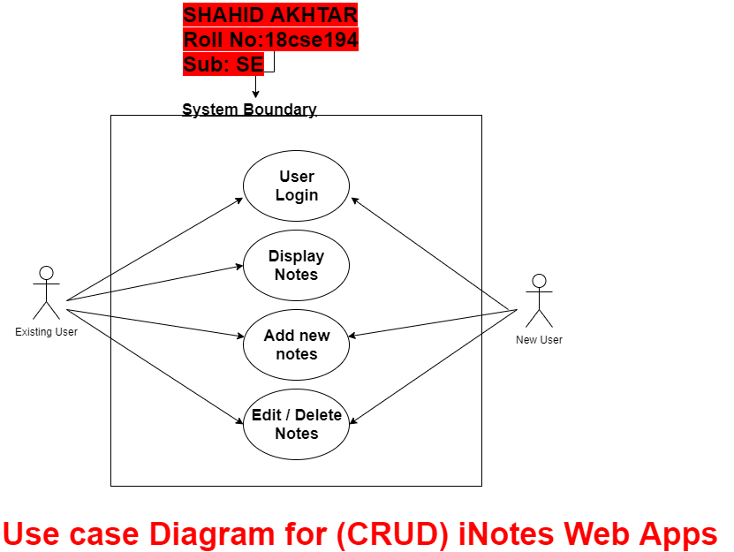
Design & Development

Slide 10
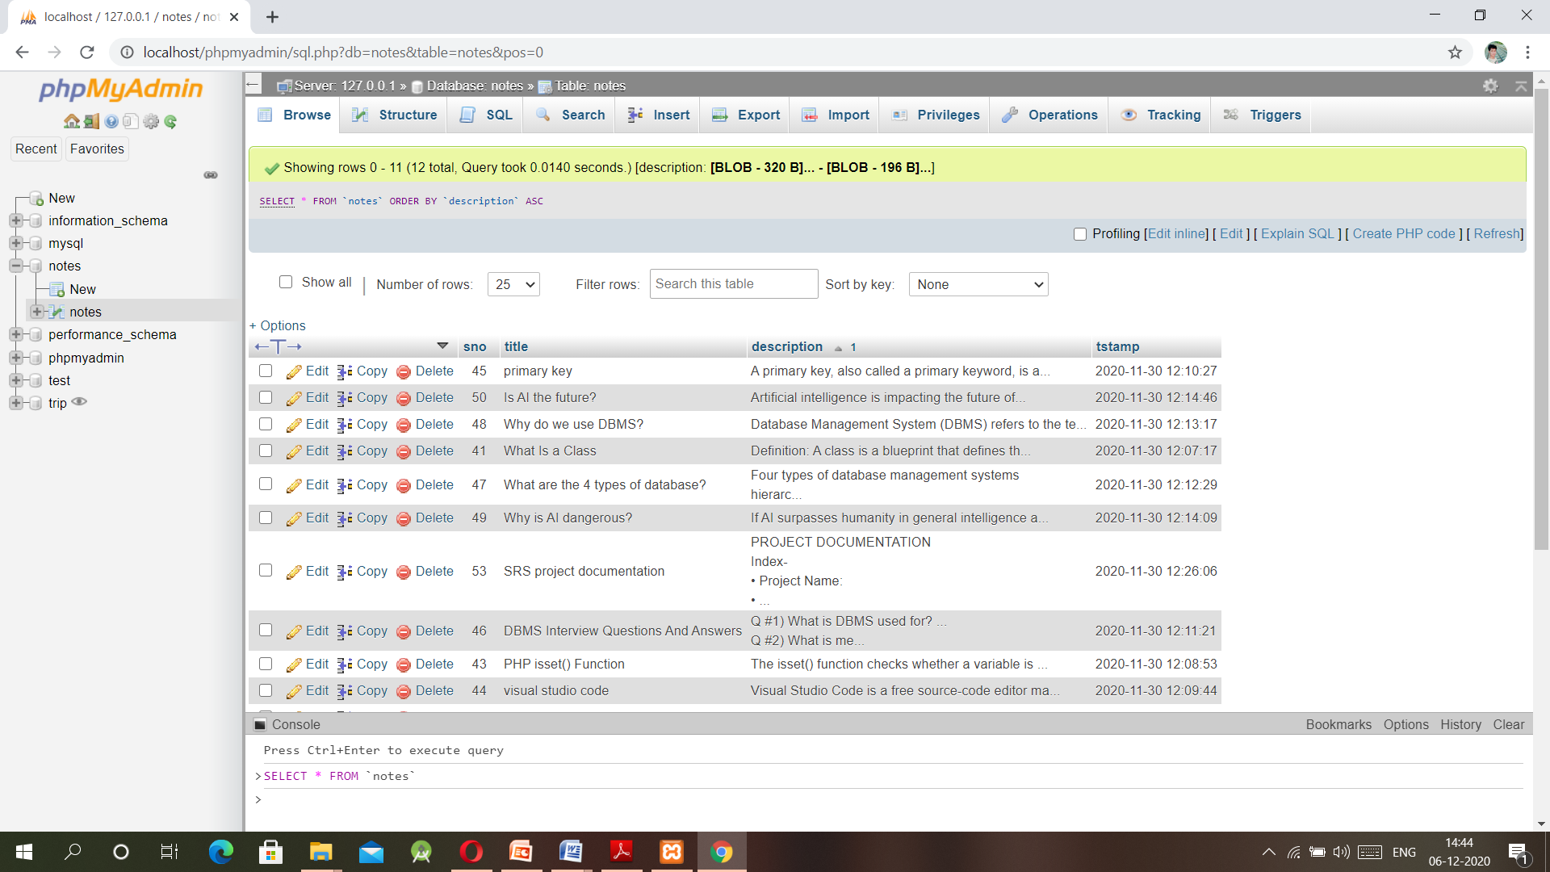
Result & ScreenShot:-

Slide 11
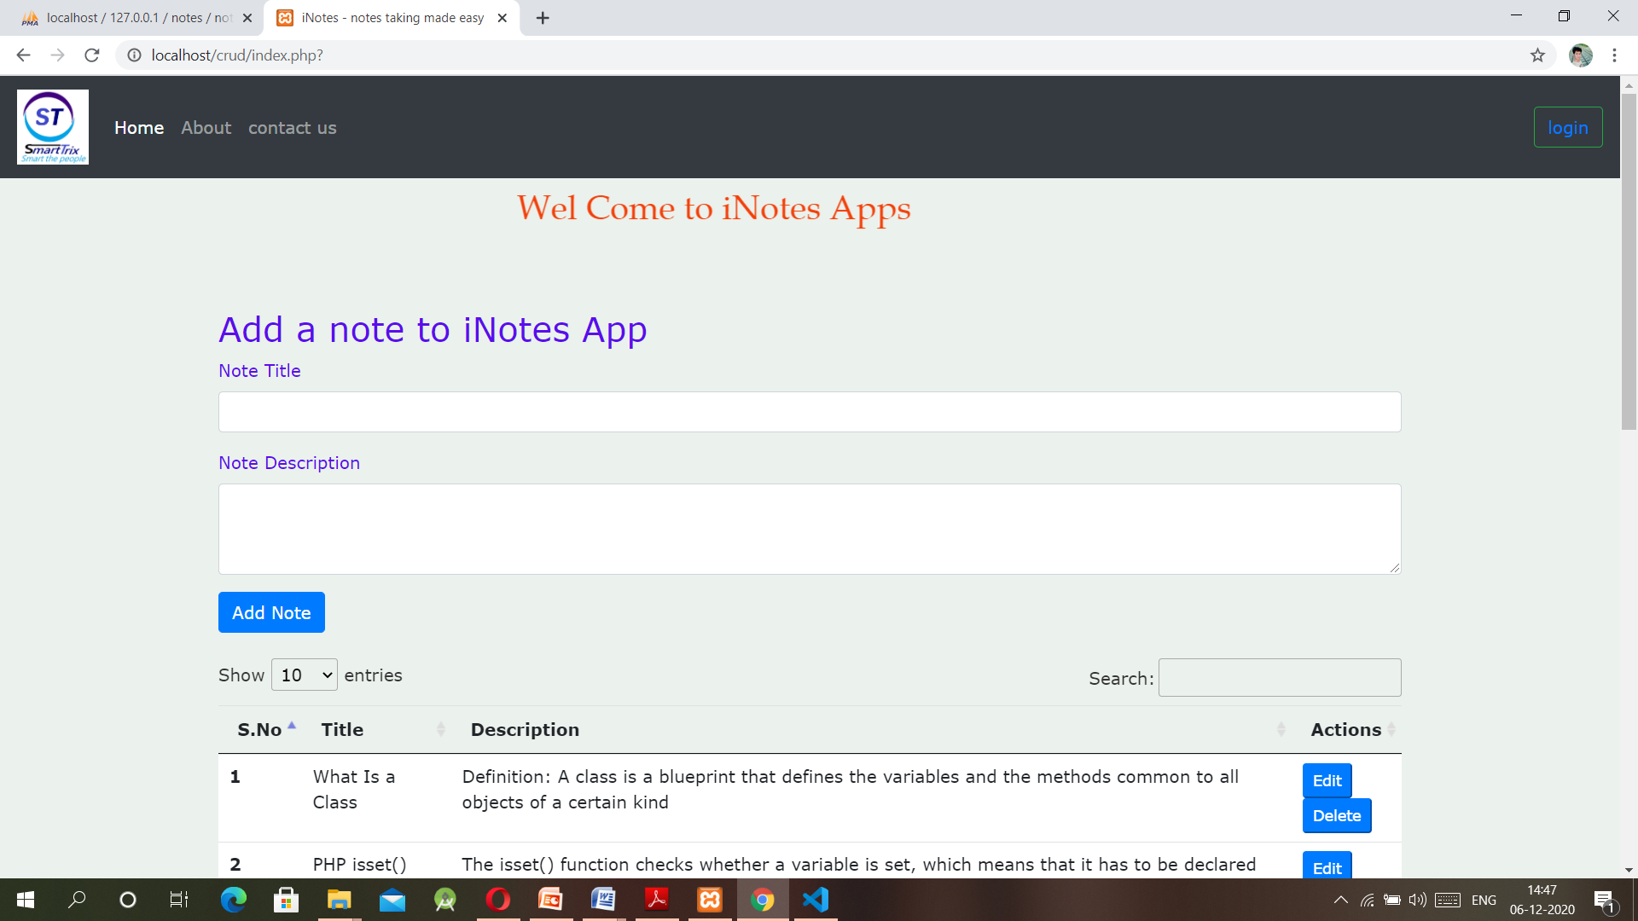
iNotes Apps view mode

Slide 12
Future Scope & Conclusion:-
This web application have almost all the features of CRUD and smart online/offline notes taking.
The project has altos benefits. Managing the project is quite easy as per as storing the notes. It is easy to maintain notes and update as we required.
As we know that the technology is increasing day by day so the hard copy note taking will be decreased, at that time it will helpful for those who will use this apps.
Still there is some additional features is not added in the apps .As we are seeking of features, if its required we will add it as soon as possible.
One of the most important principles of Software Design is to keep the software simple yet effective. This has been the guiding force during the design phase of our software. And the Interface that we provide is no exception. Against the backdrop of this ideology we design a simple yet very effective interface. Hope every user have clear idea of using our “iNotes” Apps.

